Slide 1
Xây dựng website bán sản phẩm handmade cho cửa hàng X

Slide 2
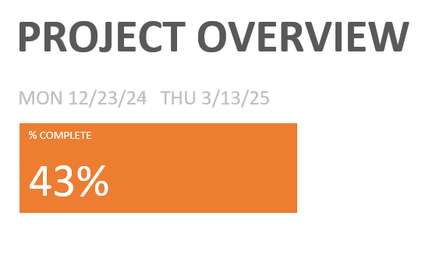

Slide 3
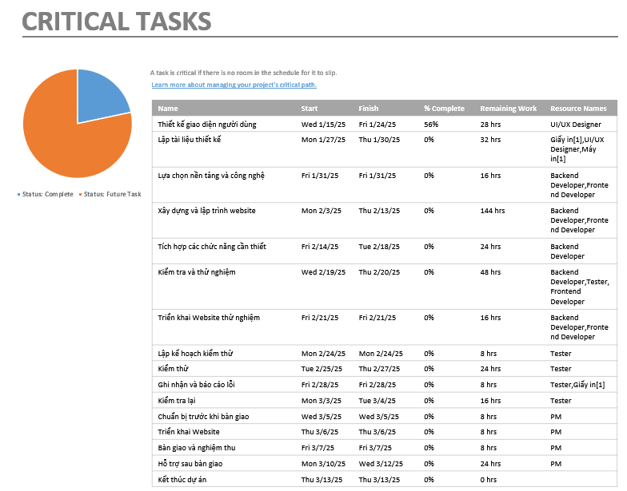

Slide 4
Resource Overview
Resource Stats
Work Status
Resource Status
Name | Start | Finish | Remaining Work
PM | Mon 12/23/24 | Wed 3/12/25 | 48 hrs
Analyst | Mon 12/23/24 | Tue 1/14/25 | 0 hrs
Frontend Developer | Fri 1/31/25 | Fri 2/21/25 | 104 hrs
Backend Developer | Fri 1/31/25 | Fri 2/21/25 | 128 hrs
Tester | Wed 2/19/25 | Tue 3/4/25 | 72 hrs
UI/UX Designer | Wed 1/15/25 | Thu 1/30/25 | 72 hrs

Slide 5
Resource Cost Overview
COST STATUS
COST DETAILS
Name | Actual Work | Actual Cost | Standard Rate
PM | 24 hrs | $14,400.00 | $600.00/hr
Analyst | 144 hrs | $57,600.00 | $400.00/hr
Frontend Developer | 0 hrs | $0.00 | $380.00/hr
Backend Developer | 0 hrs | $0.00 | $420.00/hr
Tester | 0 hrs | $0.00 | $200.00/hr
UI/UX Designer | 72 hrs | $26,640.00 | $370.00/hr

